Slide 1
Tutorial Week 4
Dr. Jay Wang

Slide 2
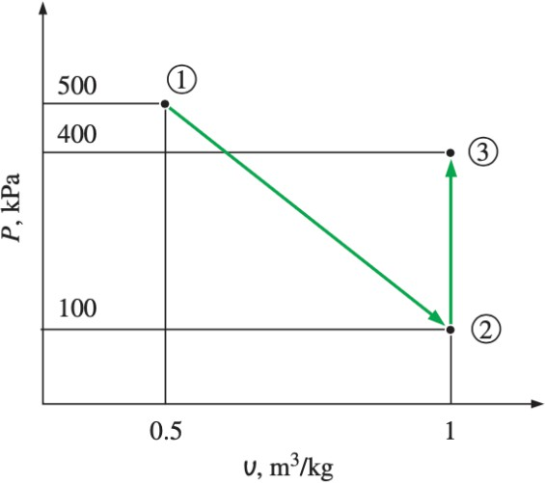
Q1) Calculate the total work, in kJ, for process 1–3 shown in the figure below when the system consists of 3 kg of nitrogen.
2 Expansion process
2 3 Constant volume process

Slide 3
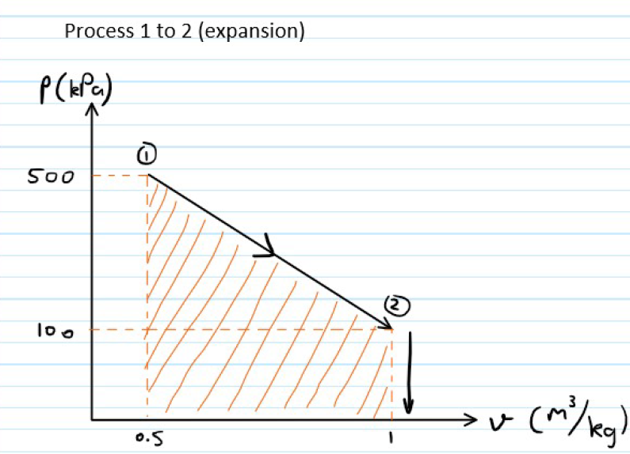
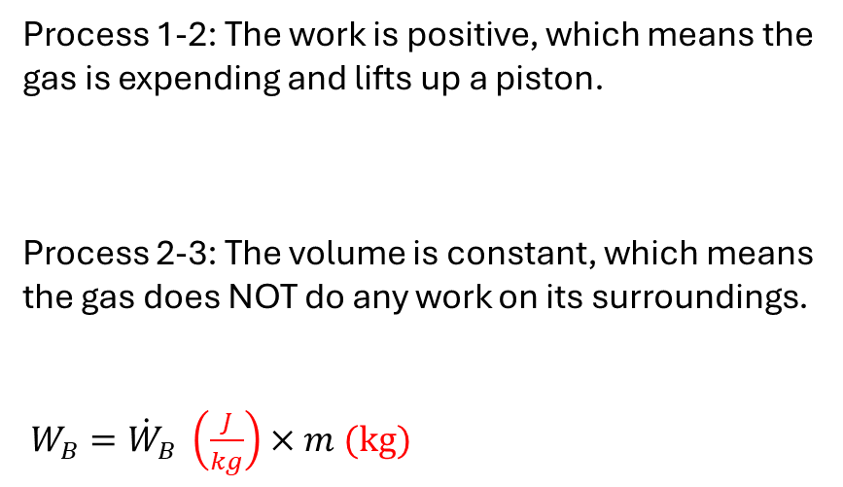
Q1) Calculate the total work, in kJ, for process 1–3 shown in the figure below when the system consists of 3 kg of nitrogen.
Process 1-2: The work is positive, which means the gas is expending and lifts up a piston.
Process 2-3: The volume is constant, which means the gas does NOT do any work on its surroundings.
$W_{B}={\dot{W}}_{B} \left(\frac{J}{kg}\right)×m (kg)$

Slide 4
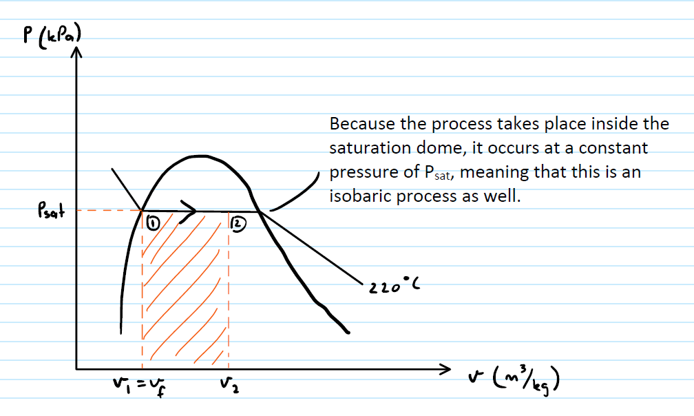
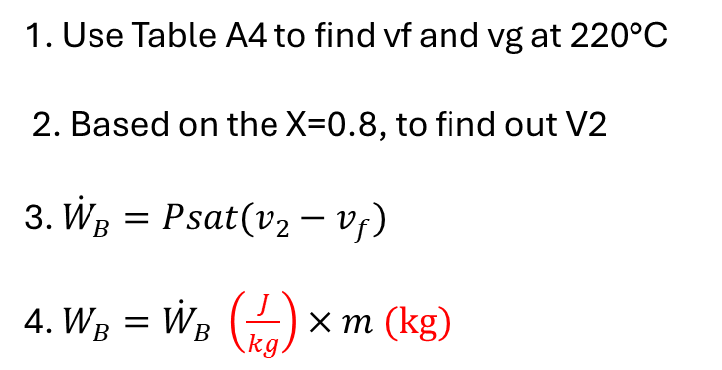
Q2) 2 m³ of saturated liquid water at 220°C is expanded isothermally in a closed system until its quality is 80 percent. Determine the total work produced by this expansion, in kJ.
1. Use Table A4 to find vf and vg at 220°C
2. Based on the X=0.8, to find out V2
3. ${\dot{W}}_{B}=Psat(v_{2}−v_{f})$
4. $W_{B}={\dot{W}}_{B} \left(\frac{J}{kg}\right)×m (kg)$

Slide 5
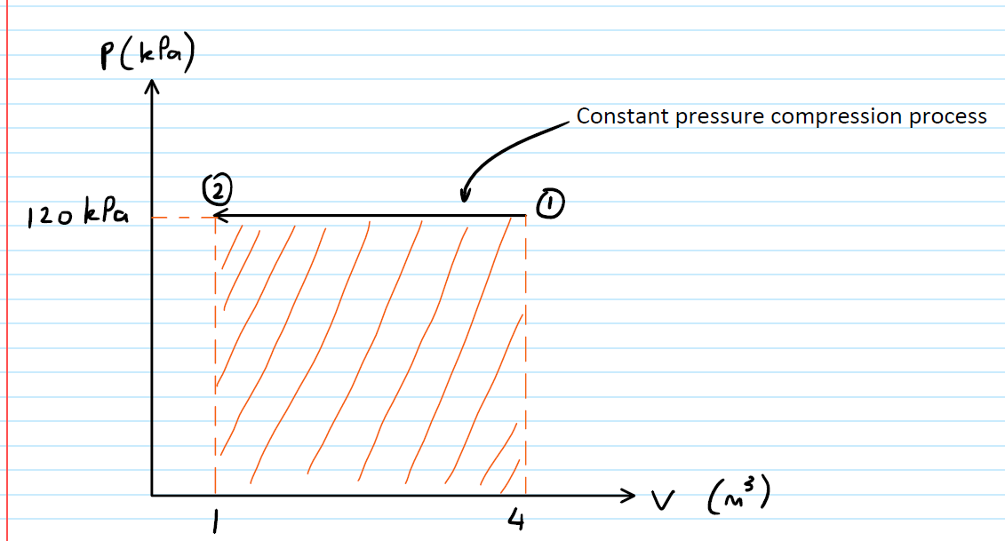
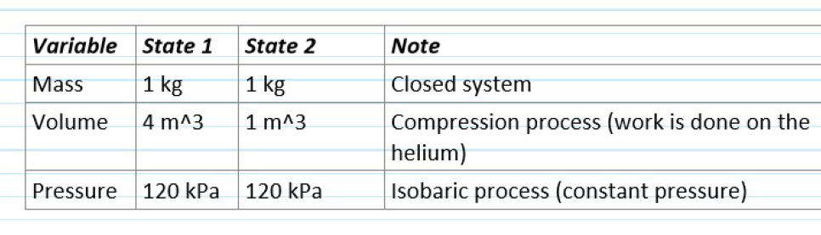
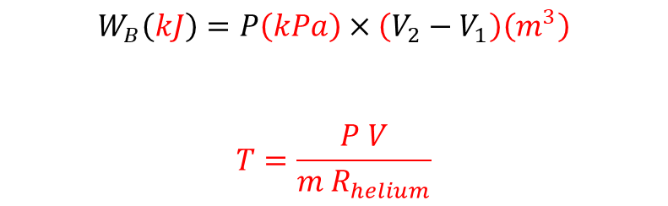
Q3) The volume of 1 kg of helium in a piston–cylinder device is initially 4 m³. Now helium is compressed to 1 m³ while its pressure is maintained constant at 120 kPa. Determine the initial and final temperatures of helium as well as the work required to compress it, in kJ.
$$W_{B}\left(kJ\right)=P\left(kPa\right)×\left(V_{2}−V_{1}\right)\left(m^{3}\right)$$
$$T=\frac{P V}{m{ R}_{helium}}$$

Slide 6
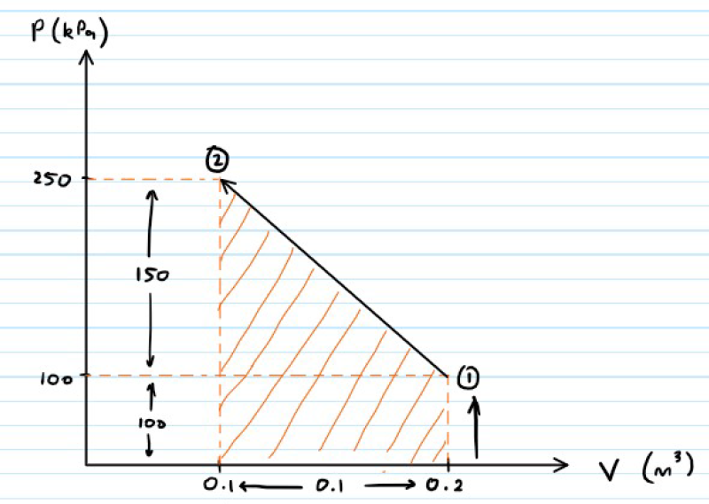
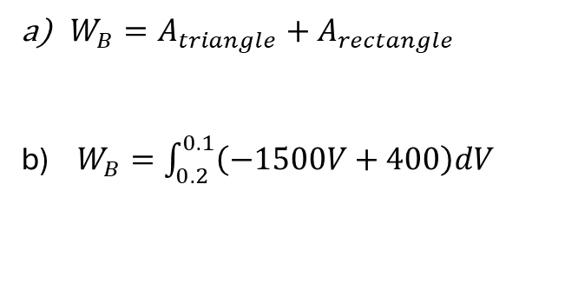
Q4) A gas is compressed from an initial volume of 0.2 m³ to a final volume of 0.1m³. During the quasi-equilibrium process, the pressure changes with volume according to the relation P = aV + b, where a = –1500 kPa/m³ and b = 400 kPa. Calculate the work done during this process: (a) by plotting the process on a P-V diagram and finding the area under the process curve and (b) by performing the necessary integrations.
$W_{B}=A_{triangle}+A_{rectangle}$
$W_{B}=\int_{0.2}^{0.1}{\left(−1500V+400\right)dV}$

Slide 7
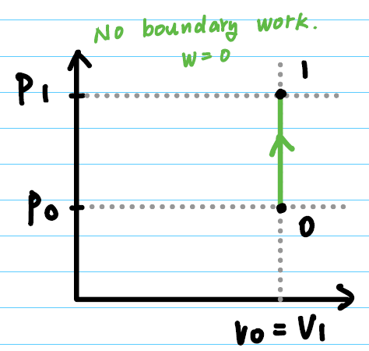
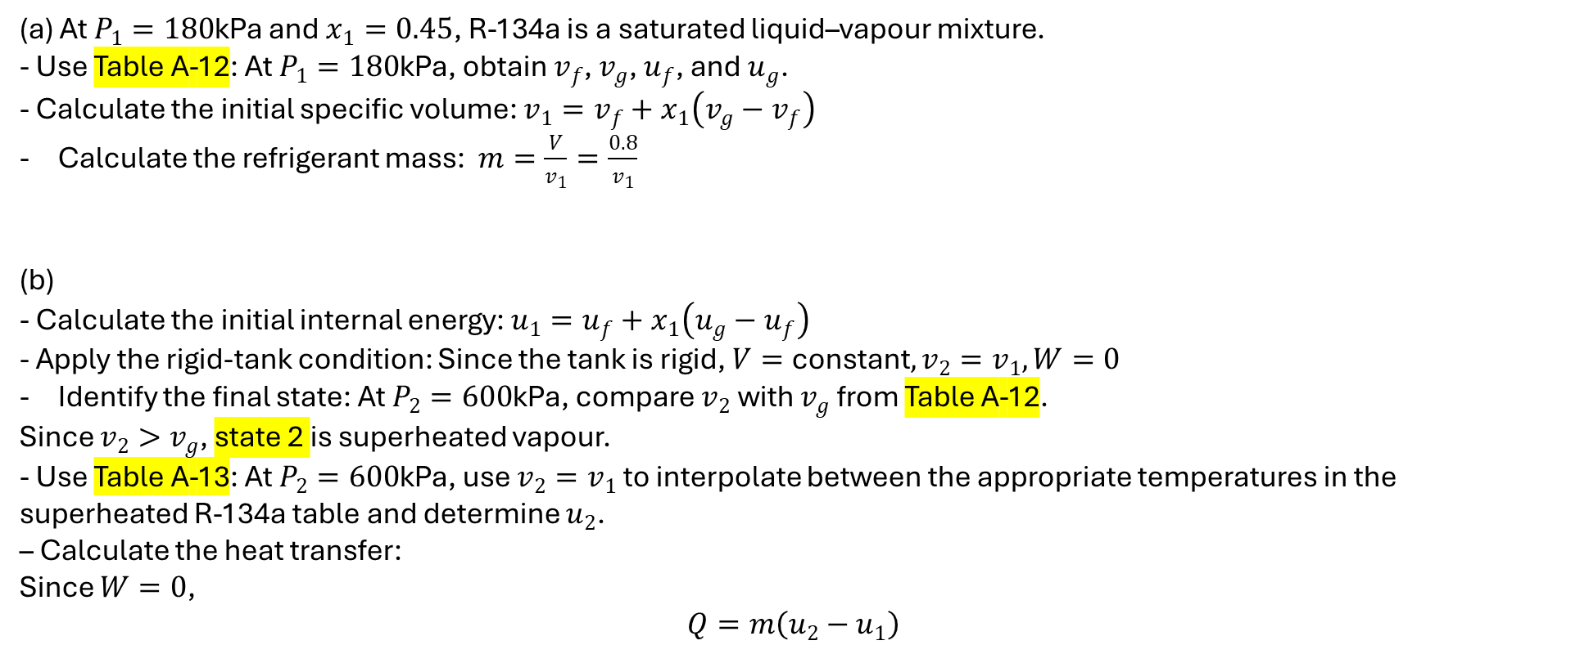
Q5) A 0.8-m³ rigid tank contains refrigerant-134a initially at 180 kPa and 45 percent quality. Heat is now transferred to the refrigerant until the pressure reaches 600 kPa. Determine (a) the mass of the refrigerant in the tank and (b) the amount of heat transferred. Also, show the process on a P-v diagram with respect to saturation lines.
(a) At $P_{1}=180$kPa and $x_{1}=0.45$, R-134a is a saturated liquid–vapour mixture.
- Use Table A-12: At $P_{1}=180$kPa, obtain $v_{f}$, $v_{g}$, $u_{f}$, and $u_{g}$.
- Calculate the initial specific volume: $v_{1}=v_{f}+x_{1}\left(v_{g}−v_{f}\right)$
Calculate the refrigerant mass: $m=\frac{V}{v_{1}}=\frac{0.8}{v_{1}}$
(b)
- Calculate the initial internal energy: $u_{1}=u_{f}+x_{1}\left(u_{g}−u_{f}\right)$
- Apply the rigid-tank condition: Since the tank is rigid, $V=\text{constant}, v_{2}=v_{1}, W=0$
Identify the final state: At $P_{2}=600$kPa, compare $v_{2}$ with $v_{g}$ from Table A-12.
Since $v_{2}>v_{g}$, state 2 is superheated vapour.
- Use Table A-13: At $P_{2}=600$kPa, use $v_{2}=v_{1}$ to interpolate between the appropriate temperatures in the superheated R-134a table and determine $u_{2}$.
– Calculate the heat transfer:
Since $W=0$,
$$Q=m\left(u_{2}−u_{1}\right)$$

Slide 8
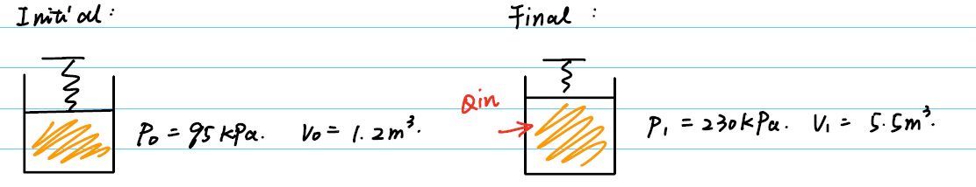
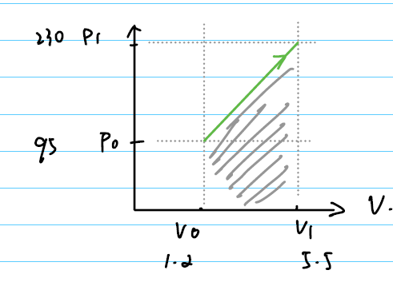
Q6) Steam at 95 kPa and 5 percent quality is contained in a spring-loaded piston–cylinder device, with an initial volume of 1.2 m³. Steam is now heated until its volume is 5.5 m³ and its pressure is 230 kPa. Determine the heat transferred to and the work produced by the steam during this process.

Slide 9
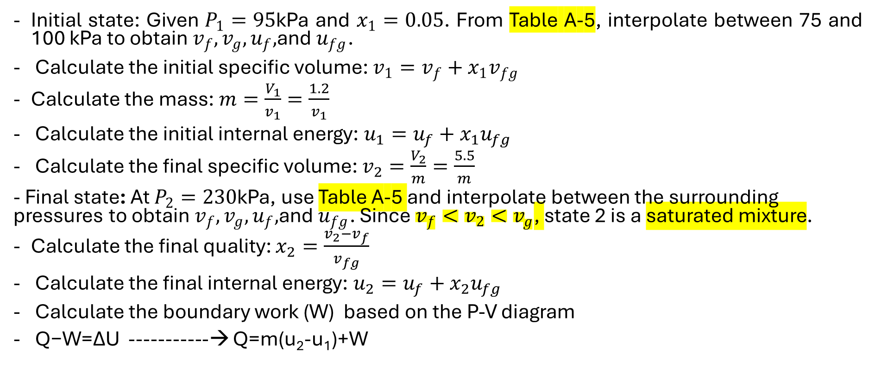
Q6) Steam at 95 kPa and 5 percent quality is contained in a spring-loaded piston–cylinder device, with an initial volume of 1.2 m³. Steam is now heated until its volume is 5.5 m³ and its pressure is 230 kPa. Determine the heat transferred to and the work produced by the steam during this process.
Initial state: Given $P_{1}=95$kPa and $x_{1}=0.05$. From Table A-5, interpolate between 75 and 100 kPa to obtain $v_{f},v_{g},u_{f},$and $u_{fg}$.
Calculate the initial specific volume: $v_{1}=v_{f}+x_{1}v_{fg}$
Calculate the mass: $m=\frac{V_{1}}{v_{1}}=\frac{1.2}{v_{1}}$
Calculate the initial internal energy: $u_{1}=u_{f}+x_{1}u_{fg}$
Calculate the final specific volume: $v_{2}=\frac{V_{2}}{m}=\frac{5.5}{m}$
- Final state: At $P_{2}=230$kPa, use Table A-5 and interpolate between the surrounding pressures to obtain $v_{f},v_{g},u_{f},$and $u_{fg}$. Since $v_{f}<v_{2}<v_{g}$, state 2 is a saturated mixture.
Calculate the final quality: $x_{2}=\frac{v_{2}−v_{f}}{v_{fg}}$
Calculate the final internal energy: $u_{2}=u_{f}+x_{2}u_{fg}$
Calculate the boundary work (W) based on the P-V diagram
Q−W=ΔU -----------→ Q=m(u₂-u₁)+W

Slide 10

Q7) Long cylindrical steel rods (ρ = 7833 kg/m³ and cp = 0.465 kJ/kg·°C) of 10 cm diameter are heat-treated by drawing them at a velocity of 3 m/min through an oven maintained at 1000°C. If the rods enter the oven at 30°C and leave at a mean temperature of 400°C, determine the rate of heat transfer to the rods in the oven.
Calculate the rod cross-sectional area: $A=\frac{πD^{2}}{4}$
Calculate the mass flow rate: $\dot{m}=ρAV$
Apply the steady-flow energy balance: $\dot{Q}=\dot{m}C_{p}(T_{out}−T_{in})$

Slide 11
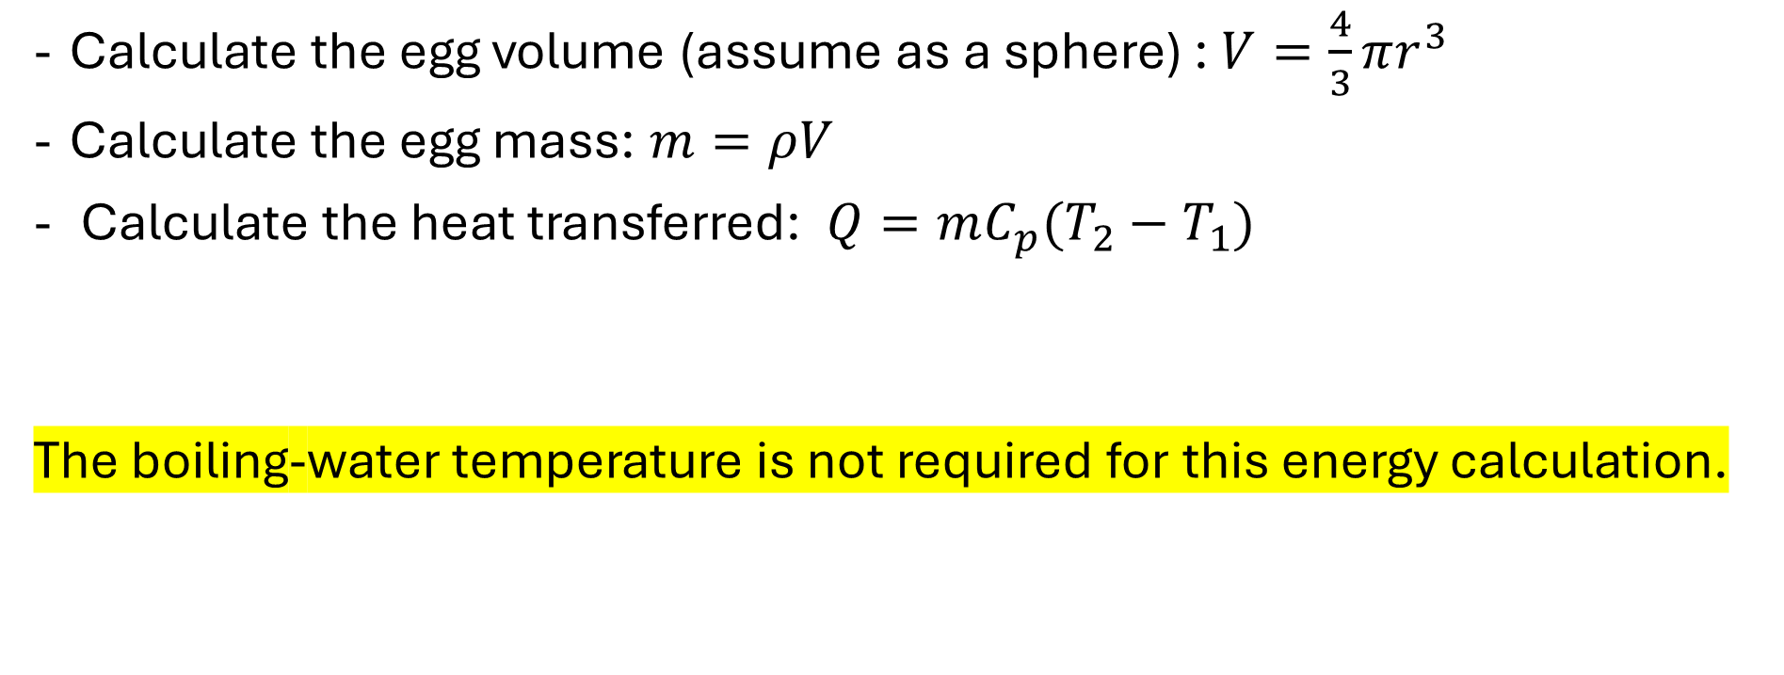
Q8) An ordinary egg can be approximated as a 5.5-cm-diameter sphere. The egg is initially at a uniform temperature of 4°C and is dropped into boiling water at 97°C. Taking the properties of the egg to be ρ = 1020 kg/m³ and cp = 3.32 kJ/kg·°C, determine how much heat is transferred to the egg by the time the average temperature of the egg rises to 90°C.
Calculate the egg volume (assume as a sphere) : $V=\frac{4}{3}πr^{3}$
Calculate the egg mass: $m=ρV$
Calculate the heat transferred: $Q=mC_{p}(T_{2}−T_{1})$
The boiling-water temperature is not required for this energy calculation.

Slide 12
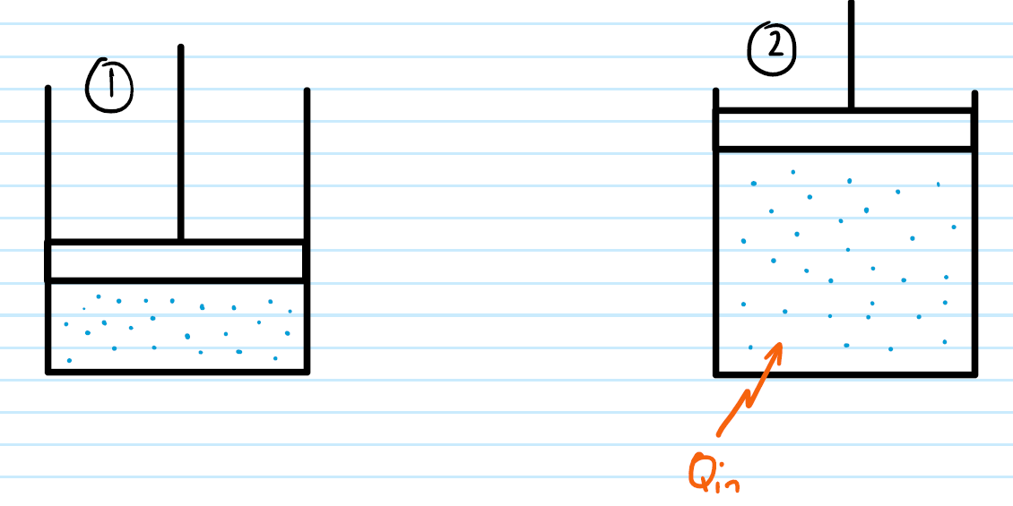
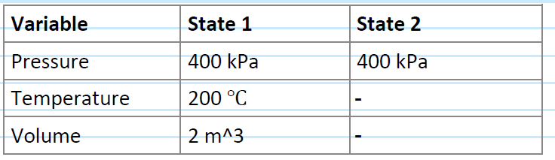
Q9) A frictionless piston is used to provide a constant pressure of 400 kPa in a cylinder containing steam originally at 200℃ with a volume of 2 m³. Calculate the final temperature if 3500 kJ of heat is added using the concept of enthalpy and the steam tables.

Slide 13
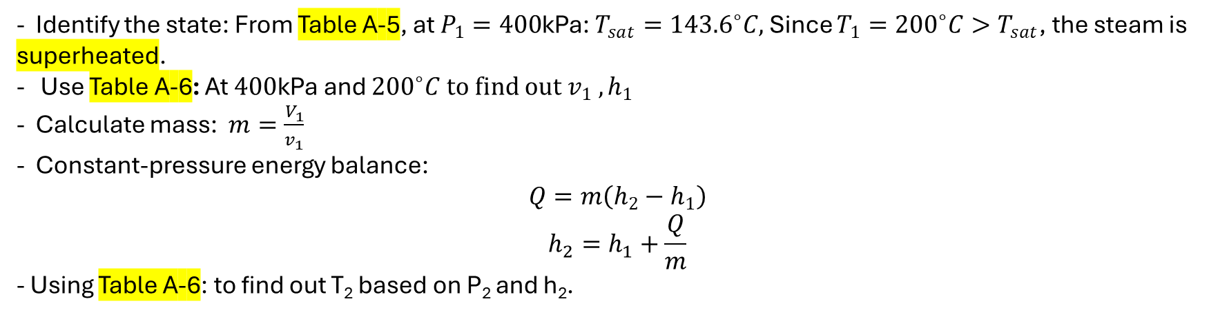
Q9) A frictionless piston is used to provide a constant pressure of 400 kPa in a cylinder containing steam originally at 200℃ with a volume of 2 m³. Calculate the final temperature if 3500 kJ of heat is added using the concept of enthalpy and the steam tables.
- Identify the state: From Table A-5, at $P_{1}=400$kPa: $T_{sat}={143.6}^{∘}C,$Since $T_{1}={200}^{∘}C>T_{sat}$, the steam is superheated.
- Use Table A-6: At $400$kPa and ${200}^{∘}C to find out v_{1} , h_{1}$
- Calculate mass: $m=\frac{V_{1}}{v_{1}}$
- Constant-pressure energy balance:
$$Q=m\left(h_{2}−h_{1}\right)$$
$$h_{2}=h_{1}+\frac{Q}{m}$$
- Using Table A-6: to find out T₂ based on P₂ and h₂.

Slide 14

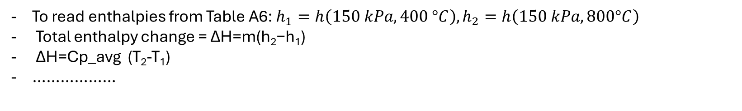
Q10) The specific heat of superheated steam at approximately 150 kPa can be determined by the equation below. (a) Determine the enthalpy change between 400℃ and 800℃ for 4 kg of steam. (b) Determine the average value of 𝐶𝑝 between 400℃ and 800℃.
To read enthalpies from Table A6: $h_{1}=h\left(150 kPa, 400 °C\right), h_{2}=h\left(150 kPa, 800°C\right)$
Total enthalpy change = ΔH=m(h₂​−h₁​)
ΔH=Cp_avg (T₂-T₁)
………………

Slide 15

11) Determine the enthalpy change for 2 kg of nitrogen which is heated from 250 K to 1300 K by (a) using the gas tables, Use M = 28 kg/kmol.
Table A-18 for molar specific enthalpies of nitrogen (at 250 K and at 1300 K)
$∆h=\frac{\overline{h_{2}}−\overline{h_{1}}}{M}$
$$∆H=m∆h$$
………

Slide 16
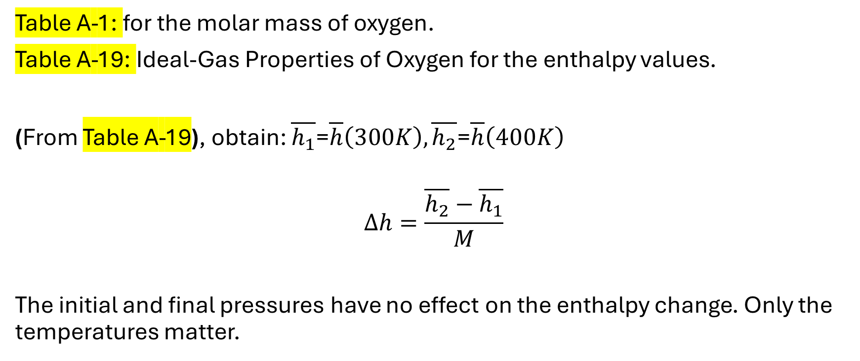
Q12) What is the change in the enthalpy, in kJ/kg, of oxygen as its temperature changes from 300 K to 400 K? Is there any difference if the temperature change were from 900 K to 1000 K? Does the pressure at the beginning and end of this process have any effect on the enthalpy change?
Table A-1: for the molar mass of oxygen.
Table A-19: Ideal-Gas Properties of Oxygen for the enthalpy values.
(From Table A-19), obtain: $\overline{h_{1}}$=$\overline{h}\left(300K\right), \overline{h_{2}}$=$\overline{h}\left(400K\right)$
$$∆h=\frac{\overline{h_{2}}−\overline{h_{1}}}{M}$$
The initial and final pressures have no effect on the enthalpy change. Only the temperatures matter.

